Slide 1
Computer Architecture
(2024)
Pipelining
College of Computer Science
Chongqing University

Slide 2
Traditional Pipeline Concept
Laundry Example
Ann, Brian, Cathy, Dave
each has one load of clothes
to wash, dry, and fold
Washer takes 30 minutes
Dryer takes 40 minutes
“Folder” takes 20 minutes
A
B
C
D
Notes:
洗衣房的例子
洗衣过程包含清洗、干燥和熨烫，其耗费的时间分别为30、40、20分钟

Slide 3
Traditional Pipeline Concept
6 PM
7
8
9
10
11
Midnight
Time
30
40
20
30
40
20
30
40
20
30
40
20
T
a
s
k
O
r
d
e
r
A
B
C
D
Sequential laundry takes 6 hours for 4 loads
If they learned pipelining, how long would laundry take?
Notes:
采用串行任务方式，4个任务，共花费了6个小时

Slide 4
Traditional Pipeline Concept
6 PM
7
8
9
10
11
Midnight
Time
30
40
40
40
40
20
T
a
s
k
O
r
d
e
r
A
B
C
D
Pipelined laundry takes 3.5 hours for 4 loads
Notes:
采用并行方式，总共只需要3.5个小时

Slide 5
Overview
Pipelining improves performance by overlapping multiple instructions
  Takes advantage of parallelism among the actions needed to execute an instruction.
  The number of instructions performed per second is increased
  The time needed for one instruction is not changed, and may be increased.
The throughput of an instruction pipeline is the measure of how often an instruction exits the pipeline.
Invisible to high level (OS, programs)
Notes:
采用流水线技术可以改善存在交叠可能的多条指令
需要利用指令之间并行的机制
每秒中执行的指令数量提上了
但是每条指令所需要的时间没有发生变化
指令流水线的吞吐量是用来衡量一个流水线的执行的速度
对于更高层的操作系统或者程序是不可见的

Slide 6
Pipeline Stages
We can divide the execution of an instruction
into the following 5 “classic” stages:
IF: Instruction Fetch
ID: Instruction Decode (w/ register fetch)
EX: Execution
MEM: Memory Access
WB: (Register) Write Back
Notes:
流水线的5阶段：
取指， 译码 ， 执行 ， 内存访问， 寄存器写回

Slide 7
Pipeline Throughput and Latency
IF
ID
EX
MEM
WB
5 ns
4 ns
5 ns
10 ns
4 ns
Consider the pipeline above with the indicated
delays. We want to know what is the pipeline
throughput and the pipeline latency.
Pipeline throughput: instructions completed per second.
Pipeline latency: how long does it take to execute a
single instruction in the pipeline.
Notes:
流水线的吞吐量和时延
- 假设流水线的每个阶段的时延分别为 5,4,5,10,4 ns
- 吞吐率为每秒中执行的数量
- 那么时延就是条指令的执行时间

Slide 8
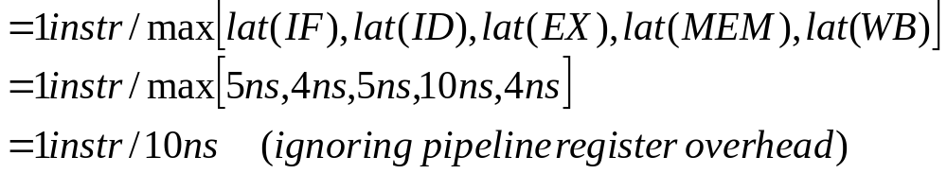
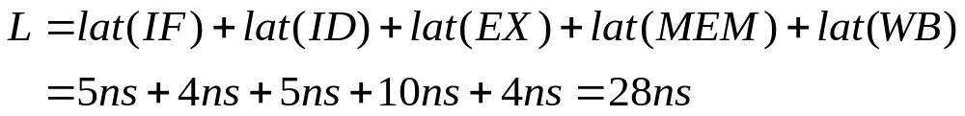
Pipeline Throughput and Latency
IF
ID
EX
MEM
WB
5 ns
4 ns
5 ns
10 ns
4 ns
Pipeline throughput: how often an instruction is completed.
Pipeline latency: how long does it take to execute an
instruction in the pipeline.
Is this right?
Notes:
吞吐量和延迟
直接将每段延时加起来，是否正确呢？后面我们接着分析

Slide 9
Pipeline Throughput and Latency
IF
ID
EX
MEM
WB
5 ns
4 ns
5 ns
10 ns
4 ns
Simply adding the latencies to compute the pipeline
latency, only would work for an isolated instruction
I1
IF
ID
EX
MEM
WB
L(I1) = 28ns
I2
IF
ID
EX
MEM
WB
L(I2) = 33ns
I3
IF
ID
EX
MEM
WB
L(I3) = 38ns
I4
IF
ID
EX
MEM
WB
L(I5) = 43ns
We are in trouble! The latency is not constant.
This happens because this is an unbalanced
pipeline. The solution is to make every state
the same length as the longest one.
Notes:
简单累加每个部件的时延，
- 只对于单独的指令有用
- 如果时候流水线的话，那么时延就会有一定的差异
如果采用非平衡的流水线，那么每条指令的时延是不同的。这对流水线的控制带来了复杂性。
解决的方式采用最长的时延最为每个阶段的时延。

Slide 10
Pipelining Lessons
Pipelining doesn’t help latency of a single task, it helps throughput of the entire workload
Pipeline rate limited by the slowest pipeline stage
Multiple tasks operating simultaneously
Potential speedup = number of pipe stages
Unbalanced lengths of pipe stages reduces speedup
Time to “fill” pipeline and time to “drain” it reduces speedup
6 PM
7
8
9
Time
T
a
s
k
O
r
d
e
r
30
40
40
40
40
20
A
B
C
D
Notes:
流水线技术无助于单个任务的延迟，它有助于整个工作负载的吞吐量
流水线速率受流水线最慢阶段的限制
多个任务同时运行
潜在加速=流水线中 阶段的数量
不平衡的流水线长度减少了加速
时间“填补”流水线和时间“消耗”它减少加速

Slide 11
Other Definitions
Pipe stage (or pipe segment)
  A decomposable unit of the fetch-decode-execute paradigm
Pipeline depth
  Number of stages in a pipeline
Machine cycle
  Clock cycle time
Latch
  Per phase/stage local information storage unit
Notes:
1.流水线阶段（或管段）
提取 - 解码 - 执行范例的可分解单元
2.流水线深度
流水线中的阶段数
3.机器周期
时钟周期时间
4. 锁存器
每个阶段/阶段的本地信息存储单元

Slide 12
Design Issues
Balance the length of each pipeline stage
Depth of the pipeline
Throughput =
Time per instruction on unpipelined machine
Problems
  Usually, stages are not balanced
  Pipelining overhead
  Hazards (conflicts)
Performance (throughput CPU performance equation)
  Decrease of the CPI
  Decrease of the cycle time
Notes:
设计问题：
1.需要平衡每个阶段的长度
2.问题
- 通常不平衡
- 流水线
- 冲突
3.性能
- 可以降低CPI
- 可以降低周期

Slide 13
We use RISC architecture to illustrate
All operations on data apply to data in registers, and typically change the entire register (32 or 64 bits per register).
The only operations that affect memory are load and store.
  Load and store operations that load or store less than a full register (e.g., a byte, 16 bits, or 32 bits) are often available.
The instruction formats are few in number, with all instructions typically being one size.
Notes:
为利用RISC 架构来说明
1.数据的所有操作都适用于寄存器中的数据，并且通常会更改整个寄存器（每个寄存器32或64位）。
2.影响内存的唯一操作是加载和存储指令。
加载或存储指令也可能使用部分寄存器（例如，字节，16位或32位）的加载和存储操作通常是可用的。
3. 指令格式数量很少，所有指令通常都是一种尺寸。

Slide 14
MIPS Instructions, one of RISC ISAs
ALU instructions
  Take either two registers or a register and a sign-extended immediate, operate on them, and store the result into a third register.
  add (DADD), subtract (DSUB), and logical operations (such as AND or OR),
  Immediate versions of these instructions use the same mnemonics with a suffix of I.
There are both signed and unsigned forms of the arithmetic instructions;
  the unsigned forms, which do not generate overflow exceptions— and thus are the same in 32-bit and 64-bit mode—have a U at the end (e.g., DADDU, DSUBU, DADDIU)..
Notes:
MIPS ，一种典型的RISC ISAS
1ALU指令
-采取两个寄存器或一个寄存器和立即符号扩展，对它们进行操作，并将结果存储到第三个寄存器中。
- 加（DADD），减（DSUB）和逻辑操作（如AND或OR），
-这些指令的即时版本使用带有后缀I的相同助记符。
2 有算术指令的有符号和无符号形式;
未产生溢出异常的无符号形式（因此在32位和64位模式下相同）在末尾具有U（例如，DADDU，DSUBU，DADDIU）。

Slide 15
MIPS Instructions, one of RISC ISAs
Load and store instructions
  base register + an immediate offset = effective address.
  In the case of a load instruction, a 2nd register acts as the destination.
  In the case of a store, the 2nd register operand is the source of the data that is stored into memory.
Branch and jump instructions:
  MIPS uses a set of comparisons between a pair of registers or between a register and zero.
  The branch destination is obtained by adding a sign-extended offset (16 bits in MIPS) to the current PC.
Notes:
1加载和存储指令
- 基址寄存器+立即偏移量=有效地址。
- 在加载指令的情况下，第二个寄存器作为目的地。
- 就存储而言，第二个寄存器操作数是存储在内存中的数据的来源。
2分支和跳转指令
- MIPS使用一对寄存器之间或寄存器和零之间的一组比较。
- 通过向当前PC添加符号扩展偏移量（MIPS中的16位）获得分支目标。

Slide 16
MIPS Instruction Formats (all 4-byte long)
I
opcode
rs₁
rd
immediate
0
5
6
10
11
15
16
31
R
opcode
rs₁
rs₂
rd
Shamt/function
0
5
6
10
11
15
16
20
21
31
J
opcode
address
0
5
6
31
Fixed-field decoding

Slide 17
Pipelined MIPS Datapath Schematic
Instruction
Fetch
Instr. Decode
Reg. Fetch
Execute
Addr. Calc
Memory
Access
Write
Back
Next PC
IF/ID
ID/EX
EX/MEM
MUX
MEM/WB
Next SEQ PC
Next SEQ PC
Adder
4
Zero?
RS1
Reg File
Address
MUX
Memory
RS2
ALU
Data
Memory
MUX
MUX
Sign
Extend
Imm
WB Data
RD
RD
RD
Data stationary control
  local decode for each instruction phase / pipeline stage
Notes:
流水线数据通路
数据平稳控制，
每条指令的各个阶段/流水线阶段，分别解码

Slide 18
The 1st stage of the 5-stage MIPS pipeline:
Instruction Fetch (IF)
Fetch the current instruction from memory according to the program counter (PC).
Update the PC to the address of the next instruction in sequence by adding 4 (since each instruction is 4 bytes) to the PC.
  IR ← Mem[PC];
  NPC ← PC + 4
Notes:
以下我们介绍5级流水线的执行过程。
第1阶段 取指令
根据程序计数器（PC）从内存中获取当前指令。
通过将PC（每条指令为4个字节）加上4，将PC更新为下一条指令的地址。
IR<-Mem [PC];
NPC<- C + 4

Slide 19
The 2nd stage of the 5-stage MIPS pipeline:
Instruction Decoding (ID) w/ Register Fetch
Decode the instruction and read the registers;
Do the equality test on the registers as they are read, for a possible branch;
Sign-extend the offset field of the instruction in case it is needed;
Compute the possible branch target address by adding the sign-extended offset to the incremented PC;
  A ← Regs[IR_{6..10}];
  B ← Regs[IR_{11..15}];
  Imm ← ((IR₁₆)¹⁶ # # IR_{16..31})
In an aggressive implementation, branch instruction can be completed → by storing the target address into the PC, if the condition test yielded true;
Notes:
第2阶段 译码 /寄存器读
- 解码指令并读取寄存器;
- 对于可能的分支，在读取寄存器时进行相等性测试;
-在需要的情况下符号扩展指令中偏移量字段;
-通过向递增的PC添加符号扩展偏移量来计算可能的分支目标地址;
A<-Regs [IR6..10];
B<-Regs [IR11..15];
Imm<-（（IR16）16＃＃IR16..31）
- 在积极的实现中，分支指令可以完成，如果条件测试结果为真，通过将目标地址存储到PC中，;

Slide 20
3rd Instruction cycle: Execution (EX)
Execution or effective address calculation
  In a load-store architecture, no instruction needs to simultaneously calculate a data address and perform an operation on the data
  ALU will work on one of the two possibilities
Do one of the following operations:
  Memory reference: Base register + Immediate Offset
    ALUOutput ← A + Imm
  Register - Register ALU instruction: specified by op code
    ALUOutput ← A func B
  Register - Immediate ALU instruction: specified by op code
    ALUOutput ← A func Imm
Notes:
阶段3 ： 执行或有效地址计算
在加载存储体系结构中，没有指令需要同时计算数据地址并对数据执行操作
ALU将致力于两种可能性之一
执行以下操作之一：
存储器参考：基址寄存器+立即偏移
ALUOutput<- A + Imm
寄存器 - 寄存器ALU指令：由操作码指定
ALUOutput<- A func B
寄存器 - 立即ALU指令：由操作码指定
ALUOutput<-Aunc Imm

Slide 21
4th Instruction cycle: Memory Access (MEM)
Memory access
  Memory reference
    PC NPC
    LMD Mem[ALUOutput] (load)
    Mem[ALUOutput] B (store)
Notes:
阶段4
内存访问周期，读内存或者写内存
NPC->PC 对于跳转指令吗？
对于Load 指令 读内存， 对于写指令则将 数据写入计算的地址中

Slide 22
5th Instruction cycle: Write Back (WB)
Write-back (WB)
  Register - register ALU instruction
    Regs[IR_{16..20}] ALUOutput
  Register - immediate ALU instruction
    Regs[IR_{11..15}] ALUOutput
  Load instruction
    Regs[IR_{11..15}] LMD
Notes:
阶段 ： 写回寄存器的操作
对于RR 、RI 以及Load指令则分别执行结果的写回目标寄存器

Slide 23
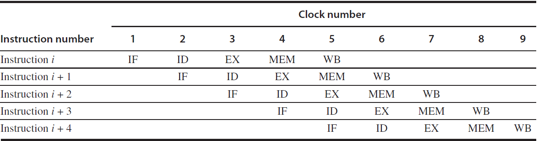
Summary: The classic 5-stage pipeline
Branch: 2 cycles, finish at ID;
Store 4 cycles, finish at MEM;
All other instructions: 5 cycles, finish at WB.
Assuming 12% branch instructions, 10% store instructions, leads to an overall CPI of 4.54.
Notes:
总结： 经典的5级流水操作
- 分枝操作 ： 2 个周期，在ID 阶段结束
- 存储指令 4个周期
- 其它的指令则采用 5个周期，在WB 阶段结束
- 假设 12%的分枝指令，10%的存储指令，导致总的平均的CPI 大约为 4.54
2*0.12 + 4*0.1 + 5* 0.78=0.24+0.4+3.9=4.54

Slide 24
Pipelined MIPS Datapath Schematic
Instruction
Fetch
Instr. Decode
Reg. Fetch
Execute
Addr. Calc
Memory
Access
Write
Back
Next PC
IF/ID
ID/EX
EX/MEM
MUX
MEM/WB
Next SEQ PC
Next SEQ PC
Adder
4
Zero?
RS1
Reg File
Address
MUX
Memory
RS2
ALU
Data
Memory
MUX
MUX
Sign
Extend
Imm
WB Data
RD
RD
RD
Data stationary control
  local decode for each instruction phase / pipeline stage
Notes:
流水线数据通路的原理图
--数据静态控制
每条指令的各个阶段/流水线阶段的局部解码信息

Slide 25
Pipeline Resources
IM
Reg
DM
Reg
ALU
IM
Reg
DM
Reg
ALU
IM
Reg
DM
Reg
ALU
IM
Reg
DM
Reg
ALU
IM
Reg
DM
Reg
ALU
Notes:
流水线中各个阶段，每条指令对资源的使用情况，红色部分为该阶段使用的资源（部件）
对于寄存器堆是在时钟的上升沿写入，下降沿读出。

Slide 26
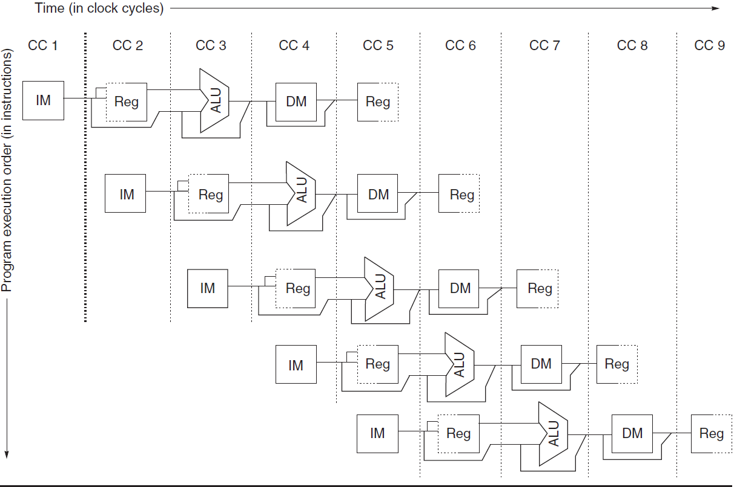
The challenge on designing a pipelined datapath
Need to make sure that a hardware unit is not asked to perform two operations in the same cycle.
  For example, an ALU cannot be asked to compute an effective address and perform a subtract operation at the same time.
IM: instruction memory
DM: data memory
CC: clock cycles
Notes:
设计流水线数据通路的挑战问题
1. 需要确保一个硬件单元不会在同一个时钟周期执行两项操作
例如不能要求ALU计算有效地址并同时执行减法运算。

Slide 27
Several Observations
Use separate instruction and data memories, implemented by separate instruction and data caches;
  It eliminates a conflict between instruction fetch and data memory access.
Reg is used in both ID (for reading) and WB (for writing). Hence, two reads (distinct) and one write every clock cycle;
  Notice that Write is always from earlier instruction and Reads are from later instructions.
  Perform Write on the 1st half of the cc (rising edge of clock) and Read in the 2nd half (falling edge of clock).
Operations on PC are not shown.
  PC must be incremented every clock, and must be done at IF in preparation for the next instruction.
  A branch does not change the PC until the end of ID stage.
  This causes a problem, will be discussed shortly.
  Needs an independent adder only for PC addition/subtraction.
Notes:
几个观察点：
1.使用独立的指令和数据存储器，由独立的指令和数据高速缓存实现;
它消除了取指和数据存储器访问之间的冲突。
2.Reg用于ID（用于读取）和WB（用于写入）。 因此，每个时钟周期可以进行两个读取（不同的）和一个写入;
-请注意，Write始终来自先前的指令，Read来自后面的指令。
-在cc的前半部分（时钟的上升沿）执行写操作，在后半部分（时钟的下降沿）执行读操作。
3. 没有显式PC上的操作。
-PC必须在每个时钟都增加一次，并且必须在IF中完成以准备下一条指令。
-直到ID阶段结束，分支机构才会更改PC。
-这会导致一个问题，很快就会被讨论。
-只需要一个独立的加法器来进行PC加法/减法。

Slide 28
Performance Issues in Pipelining
Pipelining increases performance by running multiple instructions simultaneously. But it does not reduce the latency of every single instruction.
  Due to pipeline overhead, the latency of an instruction is in fact increased slightly.
Pipeline overhead 1: Imbalanced pipeline stages:
  Slowest stage dominates the total throughput.
Pipeline overhead 2: Pipeline registers and clock skew
  Registers introduce setup time into clock frequency.
  Clock skew: We assume all registers see the clock edges at the exact same time. In real work, due to physical design imperfection, some registers see edges earlier than others – clock skew.
  Hazards: we will discuss it in the next lecture.
Notes:
1.通过同时运行多条指令，流水线可以提高性能 但它不会减少每条指令的延迟。
由于流水线的开销，指令的延迟实际上略有增加。
2. 流水线先 开销1：不平衡的流水线阶段：
最慢的阶段主导总吞吐量。
3. 流水线开销 2：流水线寄存器和时钟偏移
-寄存器将设置时间引入时钟频率。
-时钟偏移：我们假设所有寄存器都在同一时间看到时钟边沿。 在实际工作中，由于物理设计不完善，有些寄存器比其他寄存器更早看到时钟偏移。
3. 冲突：我们将在下一讲中讨论它。

Slide 29

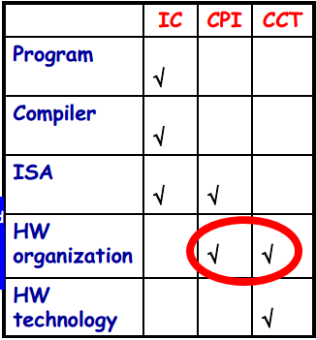

MIPS Pipelining: Basic Performance Issues
• Pipelining
– improve CPU Throughput
(reciprocal of CPU Time)
– slightly increases execution time
– result: program run faster!
• Pipelining can be seen as either
– decreasing the CPI of a multi-cycle un-pipelined implementation
– decreasing the CCT of a single-cycle un-pipelined implementation
Notes:
1.流水线
- 提高CPU吞吐量（CPU时间的倒数）
- 稍微增加了单条指令的执行时间（每一级锁存器的时间）
结果：程序运行速度更快！
2. 流水线可以同时看成
- 降低了CPI，相对于未采用流水线的多周期CPU
- 相对于未采用流水线的单周期CPU, 降低了单个时钟周期的长度

Slide 30
A question
Consider the unpipelined processor. Assume that it has a 1ns clock cycle and that it uses 4 cycles for branches and stores and 5 cycles for other operations. Assume that the relative frequencies of branch and store operations are 15% and 10%, respectively.
Consider a pipelined processor. Assume the slowest stage takes 1ns and clock skew and register setup add 0.2 ns to the clock period.
How much speedup in the instruction execution rate will we gain from an ideal pipeline?
Notes:
考虑未采用流水线的处理器。 假设它具有1ns的时钟周期，分支和访存指令4个周期，而其他指令5个周期。
假设分枝和存储操作的相对频率分别为15％和10％。
2. 考虑一个流水线处理器。 假设最慢的阶段需要1ns和时钟偏移，并且寄存器设置在时钟周期和时钟畸变导致时间增加0.2ns。
我们从理想流水线中获得的指令执行速度有多快？
下面我仔细分析一下

Slide 31
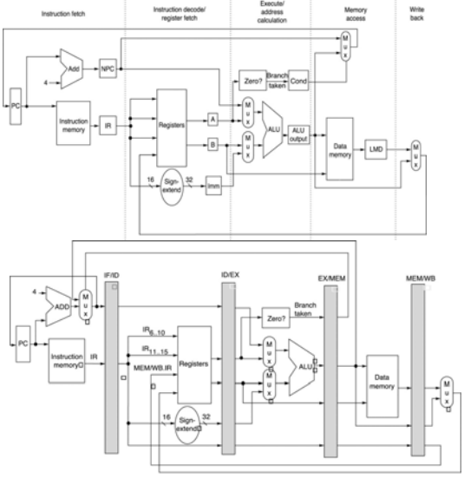
Example: Pipelining Speedup vs.
Multi-cycle Non-Pipelined Implementation
• Instruction CPI
– 4 cycles (branches and stores)
– 5 cycles (other instructions)
• Average CPI = 4.75 assuming
– 15% branches
– 10% stores
• Average Instruction ExecTime
is 4.75ns, assuming CCT = 1ns
• Ideal CPI = 1 (almost always)
• Average Instruction ExecTime
is 1.2ns with CCT = 1ns and
clock overhead = 0.2 ns
• Speedup is 3.96x for ideal
pipeline
– as we’ll see soon, in reality we
need to sum the pipeline
stalled clock cycles
Notes:
每个阶段增加0.2ns,因此每个阶段的时间需要设置为1.2ns
平均的CPI=4.75 (4 cycles (branches and stores),5 cycles (other instructions) )
当然这是一种理想的状态，
- 我们很快就会看到，实际上我们
需要对加上流水线停滞的时钟周期

Slide 32
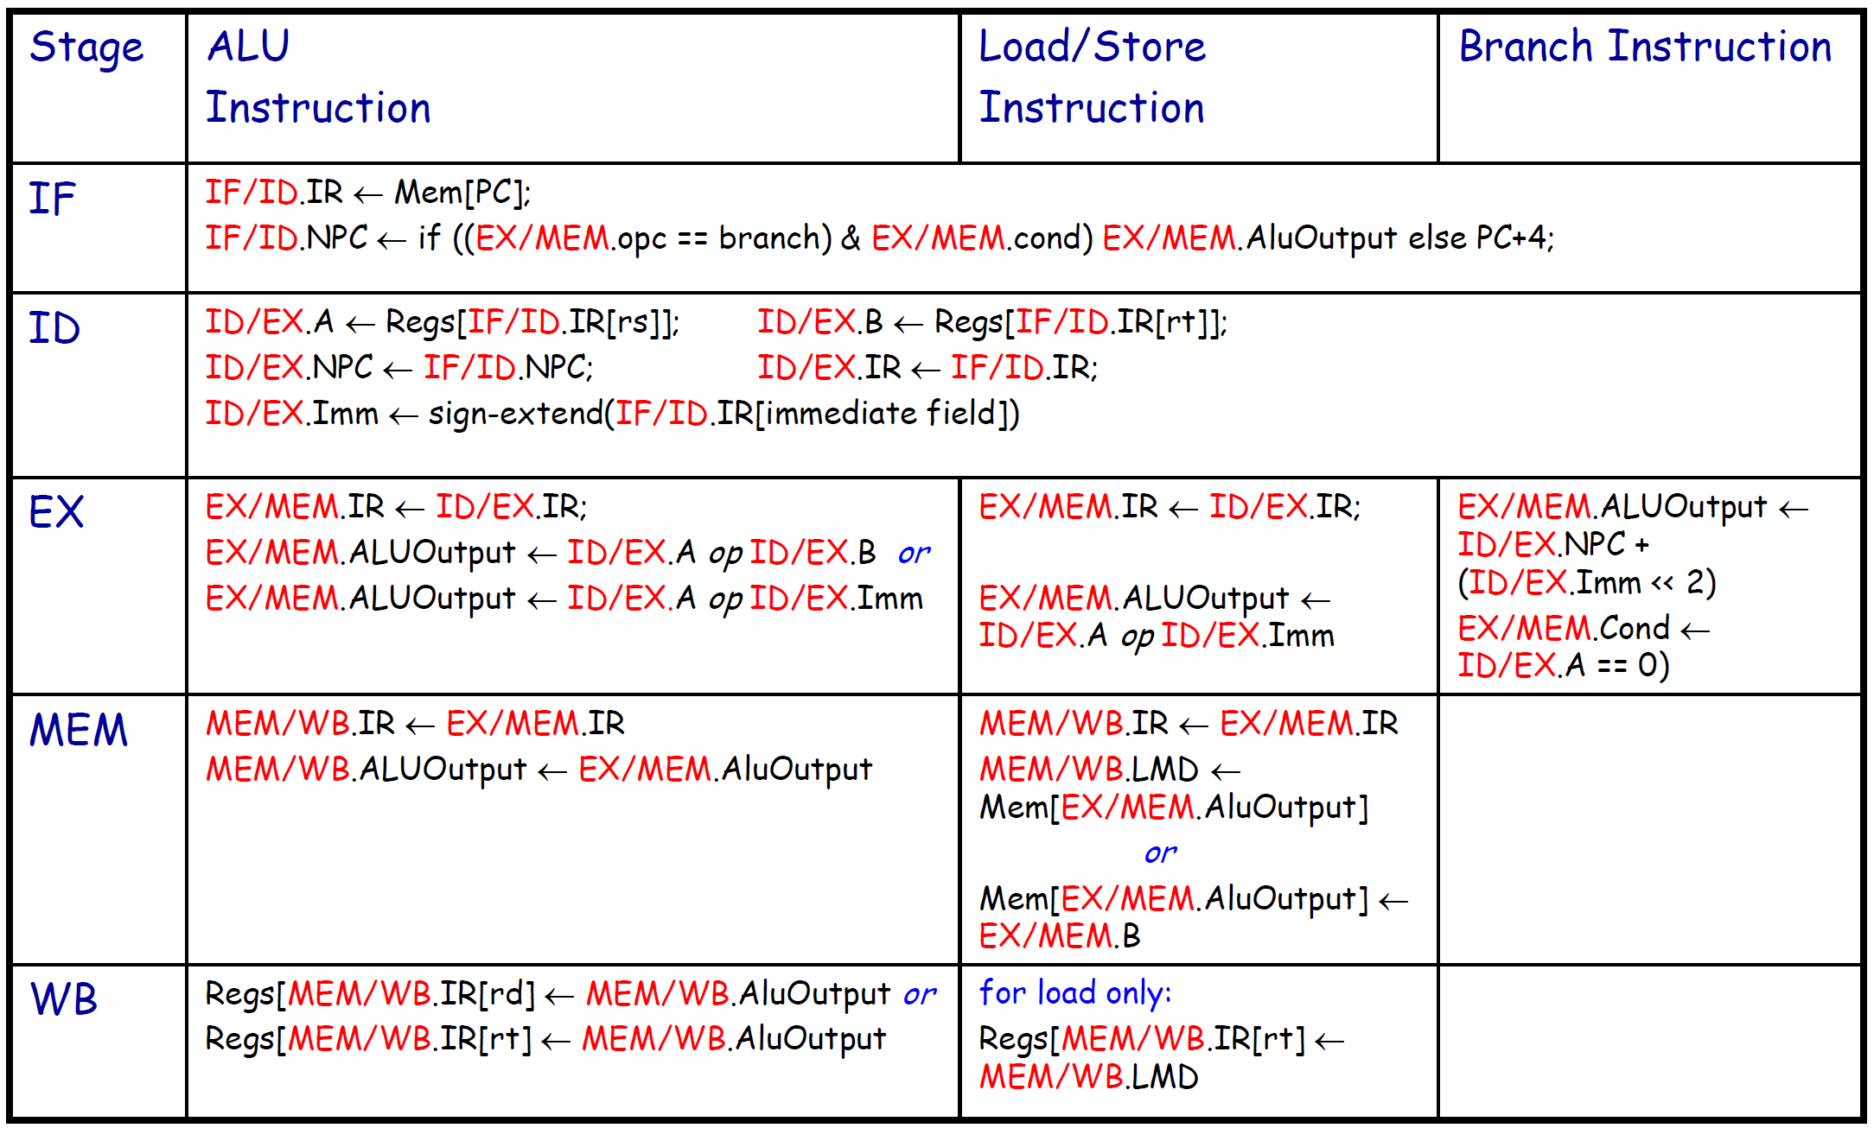
MIPS Pipeline: Events per Stage
Notes:
流水线中每个阶段的事件。
取指令阶段 中的主要操作和涉及的部件等

Slide 33
PIPELINE HAZARDS
Notes:
流水线数据冒险

Slide 34
Pipeline Hazards and Their Classification
• Pipeline hazard situation
– The next instruction cannot execute in the following clock cycle
• Three different flavors
– Structural Hazards
• arise from resource conflict: the HW cannot support all possible instruction combinations simultaneously in overlapped execution
– Data Hazards
• arise when an instruction depends on the result of a previous instruction in a way exposed by the pipeline overlapped execution
– Control Hazards
• arise from the pipelining of branches, jumps…
• Hazards may force pipeline stalling
– Instructions issued after the stalled one must stall also (and
fetching is stalled) while all those issued earlier must proceed
Notes:
1. 流水线冒险的情况下
下一条指令不能在下一个时钟周期开始执行
2. 三种不同的情况
- 结构性冒险
•由于资源冲突而产生：HW不能同时支持所有可能指令组合存在的重叠执行
- 数据数据冒险
•当指令取决于先前指令的结果时，由流水线重叠执行暴露的方式出现
- 控制冒险
•流水线中的由分支和跳转指令导致的冒险
3. 流水线冒险可能会导致流水线挂起
- 当流水线挂起后，停顿之后的发起的指令必须停顿（包括获取指令也必须挂起），但是挂起之前操作之前指令必须继续执行

Slide 35
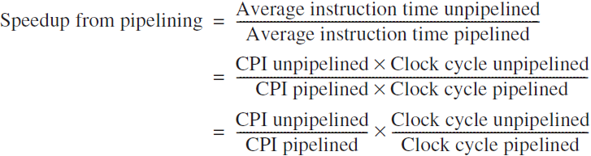


Performance of Pipelines with Stalls
Pipelining can be thought of as decreasing the CPI: This is for the case where both unpipelined version and pipelined version take the same amount of stages for instructions. Unpipelined version just does not fetch new instruction until the previous one finishes. The clock cycles of two versions are roughly same.
Clock cycle unpipelined = Clock cycle pipelined
If we ignore the pipeline overhead.
With Stalls
Speedup, assuming all instructions take the same amount of stages
Notes:
流水线可以被认为是减少了CPI：这是针对非流水线版本和流水线版本在指令阶段采用相同数量的执行阶段（Stages）。
而没有流水线的版本是直到前一条指令完成后才获取新的指令。 两个版本的时钟周期大致相同。
假设 2种 实现版本每条指令的阶段数相同， 加速比的计算公式为： 流水线的深度 / (1+ 平均每条指令暂停的周期数)

Slide 36
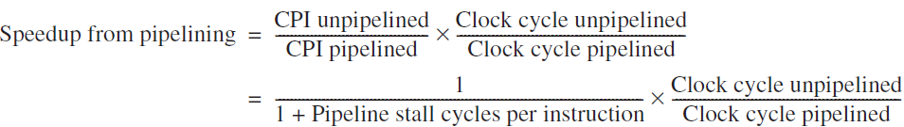
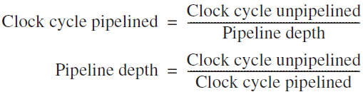
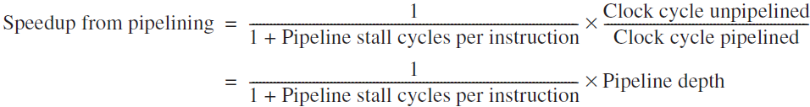
Performance of Pipelines with Stalls
Pipelining can be thought of as reducing the clock cycle: This is for the case where unpipelined version takes only one cycle for all instructions, while pipelined version take multiple stages. Hence the clock cycle of unpipelined version is more than that of the pipelined version.
In cases where the stages are perfectly balanced and there is no overhead,
the clock cycle of pipelined version is smaller than that of the unpipelined version by a factor equal to the pipeline depth:
Notes:
分析流水线性能，可以从减少指令的时钟周期数的角度分析
1.流水线也可以认为是减少时钟周期的长度：
这对于所有指令的非流水线版本只需要一个周期的情况，而流水线版本需要多个阶段。 因此，非流水线版本的时钟周期比流水线版本的时钟周期长更多。
2.在各个阶段完全平衡并且没有开销的情况下，流水线版本的时钟周期比非流水线版本的时钟周期小一个等于流水线深度的因子：
加速比=流水线的深度* 1/ (1+ 平均每条指令的暂停的周期数)

Slide 37
Structural Hazards
Overlapping instructions require:
  Pipelining of functional units
  Duplication of resources
Structural Hazard happens when the pipeline cannot accommodate some combination of instructions
Common reasons for Structural Hazard
  A unit is not fully pipelined → needs to finish current instruction before serving the next,
    e.g. an instruction takes more than one clock cycle to go through.
  Some resource has not been duplicated enough,
    e.g. a register file has only one write port, but more than one instructions in pipeline may want to write at one stage.
Consequences
  Stall the pipeline until the resource becomes available, which creates a Bubble
  Increase CPI from its ideal value
Notes:
结构冒险：
1. 多条指令同时运行需要：1）流水线化的功能单元； 2）多个资源的副本
2. 当流水线不能容纳某些指令组合时，会发生结构冒险
3. 会发生结构危险结构危害的常见原因
1）一个单元没有完全流水线 →需要完成当前的指令才能执行下一条指令， 例如 一条指令需要超过一个时钟周期才能完成。
2）有些资源没有足够的资源数量
例如 一个寄存器文件只有一个写入端口，但流水线中的多条指令可能需要在一个阶段写入。
4. 其后果为
需要暂停流水线，直到资源可用，这会创建一个气泡
导致CPI从理想取值上调

Slide 38
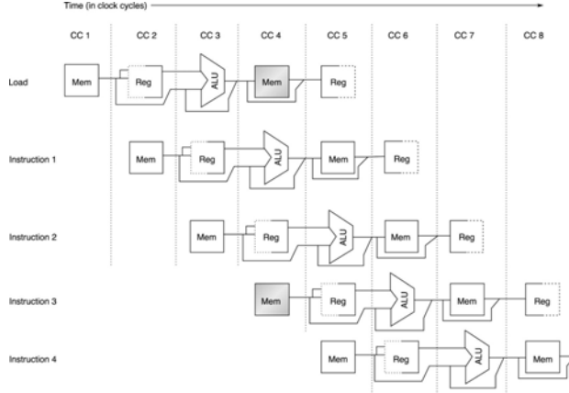
Structural Hazards: Examples
Some pipelined processors have shared a single memory for data and instructions. As a result, when an instruction contains a data memory reference (at MEM), it will conflict with the instruction reference for a later instruction (at IF)
instruction | 1 | 2 | 3 | 4 | 5 | 6 | 7 | 8 | 9
LW R10, 20(R1) | IF | ID | EX | MEM | WB
SUB R11, R2, R3 |  | IF | ID | EX | MEM | WB
ADD R12, R3, R4 |  |  | IF | ID | EX | MEM | WB
STALL
ADD R14, R5, R6 |  |  |  |  | IF | ID | EX | MEM | WB
Notes:
假设流水线处理器，使用统一的内存来存储数据和指令。
当指令包含数据存储器（在MEM中）时，它将与后一条取指令操作发生冲突（在IF中）
因此需要增加一个挂起周期，之后才能获取下一条指令。
如下图所示，在执行第三个周期时，由于第2条指令进入内存访问周期，那么测试就不能启动对第4条指令的取值操作。

Slide 39
Structural Hazards Consideration / Trade-off
Completely avoiding structural hazards is very costly :
  Pipelined functional units are more costly (pipelined FP ALU are costly)
  Duplication of resources (separate instruction and data caches means doubled memory and bandwidth)
If Structural Hazard is rare, just let it be.
  For example, if FP operations are rare, then just use a non-pipelined FP ALU.
Notes:
结构冒险考虑和折中
1.完全避免结构性危害是非常昂贵的：
-流水线功能单元成本更高（流水线FP ALU成本高昂）
-资源的复制（单独的指令和数据高速缓存意味着内存和带宽加倍）
2. 如果结构冒险很罕见，可以先放在那里，无需处理。
例如，如果FP （浮点运算）操作很少，那么只需使用非流水线的FP ALU

Slide 40
Impact of Stalls on the Performance of
Pipelined Implementation - Example
• Implementation without structural hazards
– ideal CPI = 1
– Clock Cycle = 1ns
• Implementation with the “load” structural hazard
– Clock Cycle = 0.9ns
• Suppose that
– 40% of the executed instructions are loads or stores
• Which implementation is faster?
– (averageInstructionTime)_noHaz = 1 * 1 = 1
– (averageInstructionTime)_haz = (1 + 0.4 * 1) * 0.9 = 1.26
– implementation without structural hazard is 1.26 times faster than the other
Notes:
影响对流水实现的影响 - 示例
1. 假设 无结构冒险 理想的 CPI=1 ,CC =1ns
如果存在Load 指令存在结构冒险
- 需要 即使将 CC 降低为 0.9ns 的时延
如果40%的指令是Load和store指令的话，那么新的CPI 为 1.26
结论： 尽管时钟周期降低 10%，但是如果存在结构冒险，那么性能反而会降低

Slide 41
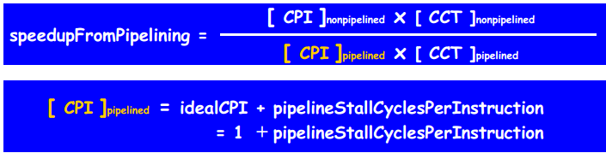

Impact of Stalls on the Performance of
Pipelined Implementation
• Special case: ignoring the pipeline clock-period overhead and assume that
– the pipeline stages are perfectly balanced
– all instructions take the same number of cycles in the non-pipelined implementation (equal to the pipeline depth)
CCT = Clock Cycle Time
Notes:
性能提升的计算方式
流水线的CPI = 理想的CPI + 每条指令挂起的周期数
特殊情况：忽略流水线时钟周期开销并假设
- 流水线阶段完美平衡
- 所有指令在非流水线实现中采用相同数量的周期（等于流水线深度）
那么 加速比为: 最下面的计算公式
加速比等于 流水线的深度 除以 （1 + 平均每条指令挂起的周期数）

Slide 42
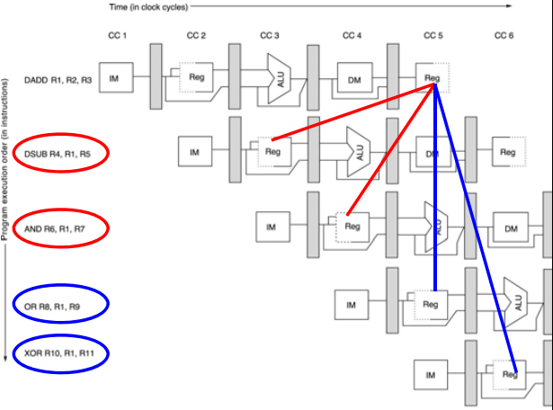
Data Hazards
Data Hazards occur when the pipeline changes the order of read/write accesses to operands so that the order differs from the order seen by sequentially executing instructions on an unpipelined processor
The red lines show data hazards.
This data hazard is called RAW (read after write)
Notes:
结构冒险可以通过增加资源来解决，或者不处理他，另一类冒险：数据冒险则更加普遍。
数据冒险：
1. 由于流水线改变对操作数的读取/写入访问顺序，这种访问顺序与指令顺序执行的方式不同，从而发导致执行的结果不一致。（存在数据冒险）
2. 红色的指令表示可能存在冒险（RAW），这种数据冒险成为写后读, 蓝色指令的表示有依赖关系，但是不存在数据冒险

Slide 43
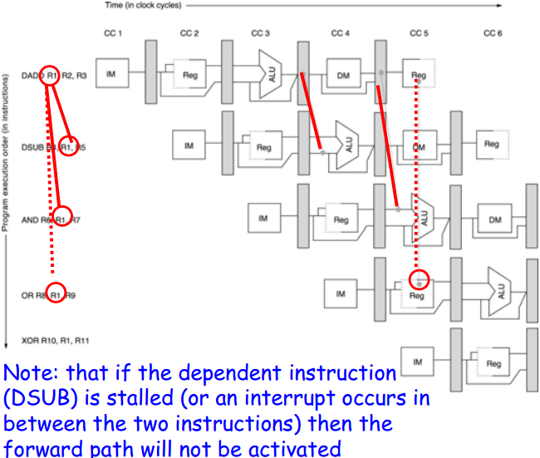
Data Hazards: Forwarding (or By-Passing)
• ALU result is
always fed back to
the ALU input
from both
EX/MEM and
MEM/WB
If the forwarding hardware detects that the previous ALU operation has written the register corresponding to a source for the current ALU operation, control logic selects the forwarded result as the ALU input rather than the value read from the register file.
Notes:
数据冒险的解决方式：通过前推或者旁路方法
1. ALU 结果总是通过 EX/MEM 和 MEM/WB 缓冲寄存，回写到 ALU 的输入通路。（采用旁路方式传输数据），当然需要增加多路选择器和控制信号。
2. 如果转发硬件检测到先前的ALU操作已经写入了与当前ALU操作的源相对应的寄存器，则控制逻辑将所转发的结果选择为ALU输入而不是从寄存器文件读取的值。
注意， 如果依赖的指令（例如DSUB）阻塞掉（或则一个中断发生在两条指令之间），那么数据前推通路不被激活

Slide 44
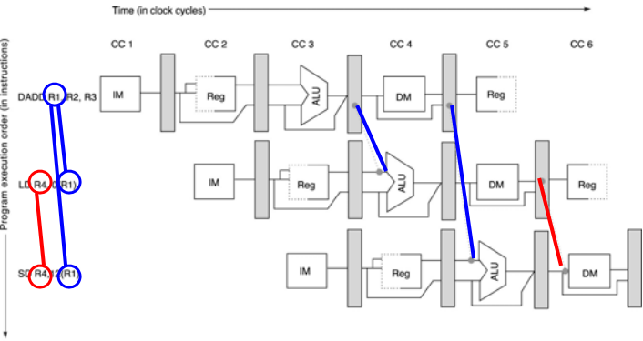
Generalized Forwarding
Sometime we need to forward results not only from the immediately previous instruction but also possibly from an instruction started 2 cycles earlier.
Generalized Forwarding: A result can be forwarded from a pipeline register of one unit to the input of another unit.
Note, without forwarding, units only receive operands from its own pipeline register.
Notes:
通用的数据前推方法：
1.有时我们不仅需要从前一个指令转发结果，而且还可能需要从2个周期前执行的指令（I(j-2)）转发其结果。
2.通用转发：结果（数据）可以从流水线单元中的寄存器转发到另一个单元的输入端口（不仅仅是寄存器，例如例子中的红色的前推通路，将数据推到数据存储器的数据端口）。
注意，没有转发，单元只接收来自其自己的流水线寄存器中的操作数。

Slide 45
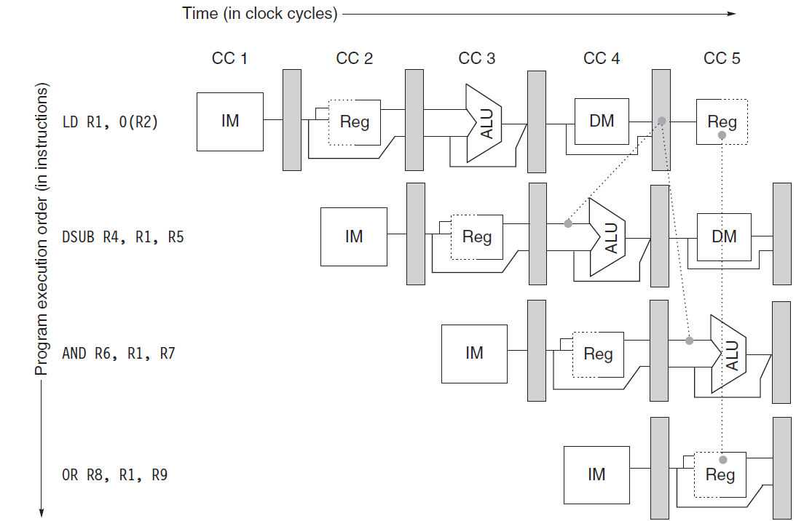
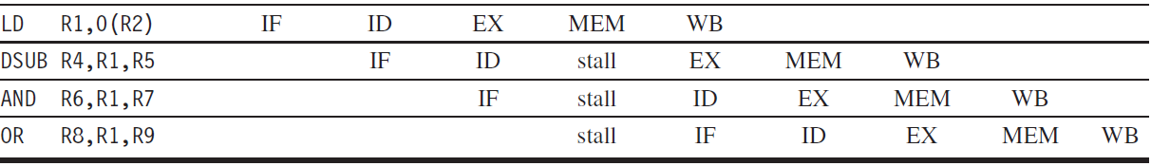
Not all Data Hazards can be solved by Forwarding
A pipeline interlock (a hardware unit) detects a hazard and stalls the pipeline until the hazard is cleared.
Notes:
并非所有数据冒险都可以通过数据前推来解决。
流水线 互联锁装置（一个硬件单元）检测数据冒险并停止流水线，直到数据冒险清除。
请同学们分析一下， 为什么？
如图所显示的4条指令，由于DSUB 指令的EX周期（第三个阶段）和LD指令访问内存周期（第4个阶段）处在同一个周期，尽管可以通过LD指令前推R1的结果到ALU输入端。但是DSUB指令必须插入一个挂起的周期，其前推的结果才是正确的结果。

Slide 46
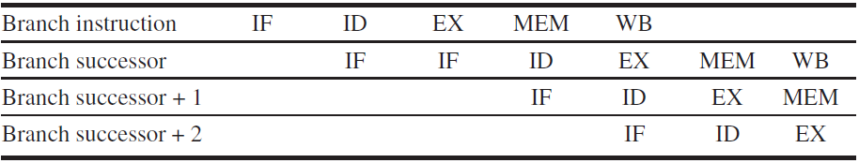
Control / Branch Hazards
Greater Performance Loss than Data Hazards
When a branch is executed, there could be two outcomes:
1. If a branch is taken (taken branch), PC will be changed to the branch address at the end of ID after the completion of the address calculation and comparison.
2. Otherwise it is called untaken branch or fall through, PC is incremented by 4 at the end of IF, PC + 4
Control Hazard: Where should the next IF get the instruction?
Simple solution: Always do 2 back-to-back IFs in the next instruction execution when a Branch instruction is decoded.
The 1st IF fetches from PC+4, like a stall.
Depending on the outcome of ID of Branch, the 2nd IF either re-fetches the same instruction from PC+4 in case fall through, or fetch the instruction from the address calculated by ID of the previous instruction.
Notes:
控制/分支冒险的性能损失大于数据危害
当一个分支被执行时，可能出现两个情况：
1.如果一个分支被采用（执行分支操作），在完成地址计算和比较之后，PC将在ID阶段结束是被改变为跳转地址。
2.否则称为未分支或继续执行，PC在IF，PC + 4的末尾增加4
控制冒险：下一个IF（取指阶段）到何处去获得指令？ 因为存在两种情况
简单的解决方案：在 ID译码分支指令时，始终在下一个指令执行中执行2次背靠背的取值IF（连续执行两条取值操作）相当于一个挂起操作。
第一个IF从PC + 4获取，就像一个挂起操作。
根据分支ID的结果，第二个IF或者从PC + 4重新获取相同的指令，或者从前一个指令的ID计算出的地址中获取指令。
该方案能够正确执行的前提是，跳转指令在第2个周期结束，形成了正确的PC值
beq rs, rt, L1；
if (rs == rt) branch to instruction labeled L1;
bne rs, rt, L1；
if (rs != rt) branch to instruction labeled L1;
j L1
unconditional jump to instruction labeled L1

Slide 47
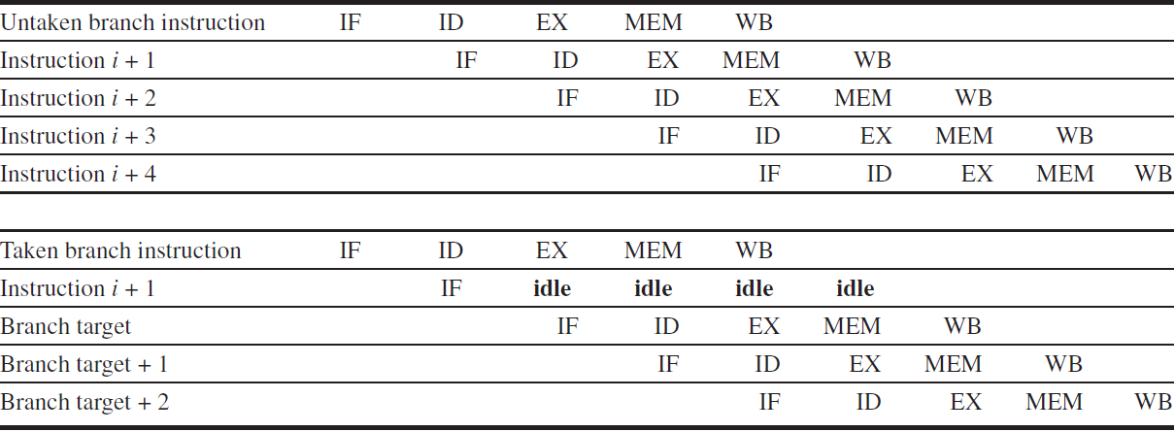
Reducing Pipeline
Branch Penalties
One stall cycle for every Branch will yield a performance loss of 10% to 30%
depending on the branch frequency!
Tech. 1: freeze or flush pipeline, like the two back-to-back IF
  Compiler holds or deletes any instructions after the branch until the branch destination is known
  Simple in hardware/software, but the penalty is fixed and can’t be reduced.
Tech 2: Guess Branch always Not Taken/Fall Through
  Always fetch IF from PC+4.
  In case Guess is right, continue as normal.
  In case Guess is wrong, since the instruction is at the ID stage, instead of decoding it, change it to a NOOP.
  Fetch the instruction from the address outcome of Branch instruction.
Notes:
减少流水线中分支指令的代价。
如果每个分支的一个停顿周期将导致10％至30％性能损失，具体损失取决于分支频率！
技术1：冻结或刷新流水线，就像两个背靠背IF
-编译器在分支后保存或删除任何指令（使用NOOP指令），具体指令数量直到分支目标已知
-在硬件/软件中很简单，但代价是固定的并且不能降低。
技术2：猜测总是不跳转 ( 但是必须小心控制，直到确定分枝方向前不能更改CPU的状态，包括寄存器的值、状态寄存器的值等)
-总是从PC + 4获取IF。
-如果猜猜是正确的，继续照常执行。（见上图）
-在猜测错误的情况下，由于指令尚处在ID阶段，而不是解码，请将其更改为NOOP（见下图）。
-从Branch指令地址计算的结果中获取指令。
beq rs, rt, L1；
if (rs == rt) branch to instruction labeled L1;
bne rs, rt, L1；
if (rs != rt) branch to instruction labeled L1;
j L1
unconditional jump to instruction labeled L1

Slide 48
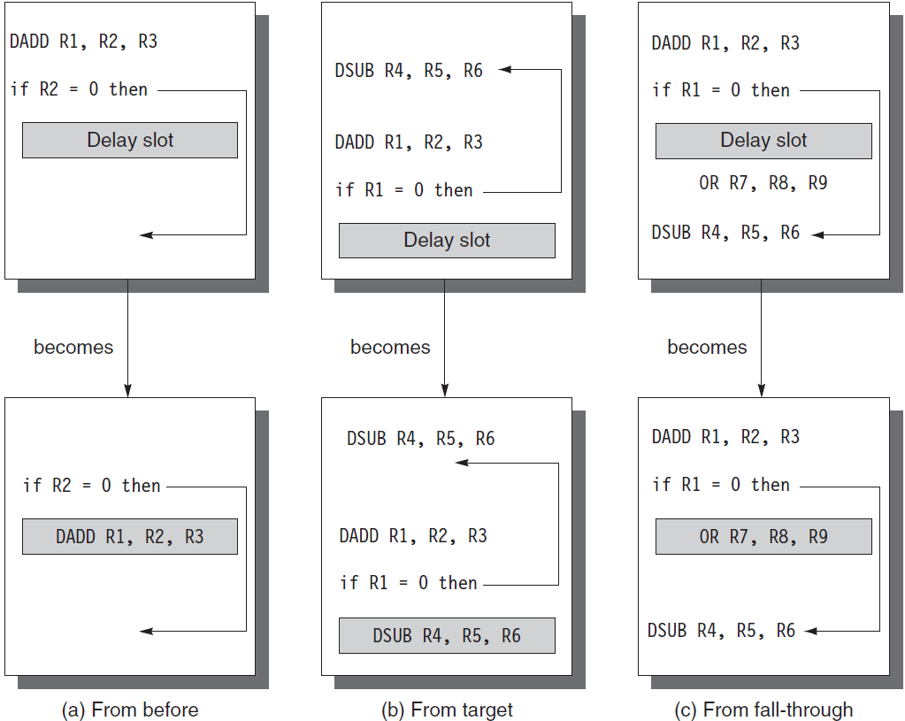
Reducing Pipeline
Branch Penalties
Tech. 3: Use a delayed branch
  Compiler schedules one instruction (or more than one depending on the need) right after the branch. The instruction(s) is always executed, after which we will know the ID outcome of the Branch instruction.
is the best.
(b) and (c) are used only when (a) is impossible.
(b) is preferred if Branch has higher probability to be taken.
(c) is preferred if otherwise.
Both (b) and (c) need to undone their changes (registers for example) if their assumptions turn out to be false!
Notes:
技术3：使用延迟分支（优化的原则是尽量不浪费机器周期）
如何填充使用延迟槽中的指令
-编译器在分支后立即安排一条指令（或根据需要安排多条指令，可以从安排跳转之前的指令 a、跳转目标地址 b 上的指令或者是该指令后继的指令 c）。
指令总是被执行，之后我们将知道分支指令的ID结果。
情况 a) 是最佳的情况， 如果在分枝指令前一条指令与分枝指令无关（无依赖关系），那么可以调整顺序的方式，并更改跳转地址来进行优化
对于情况 b) c) 则是 情况a）不可行时，则采用的优化方法
情况（b）则是将发生跳转后执行的指令填充到延迟槽中，因此对于 分枝执行概率高的，优化的效果较好
（c）则是分枝通常不执行时的优化效果较好
对于b和c两种情况下如果顺序错误，需要flush填充槽中的指令。
如果这三个位置上的指令都不行的话，就需要填充NOP指令了

Slide 49
Delayed Branch Limitations and Improvement
Limitations:
  the restrictions on the instructions that are scheduled into the delay slots
  our ability to predict at compile time whether a branch is likely to be taken or not
Processor introduces a new instruction called Canceling or Nullifying
  A canceling branch instruction includes the instruction from a predicated direction.
  If predication is right, the canceling instruction continues.
  Otherwise, this special instruction changes to NOOP.
Notes:
延后分支的局限和改进
1.限制：
-受限与对于调度到延迟槽中的指令
-受限与我们在编译时对分支预测的可能性
2. 改进的方法，处理器引入一条新的指令，称为取消或者空指令
-取消分支指令包含来自预测方向的指令。
-如果预测是正确的，则取消指令继续。
-否则，该特殊指令变为NOOP。
在MIPS 32 具体实现时，简化了上述优化措施，如果能够找到第一种情况（a）的则调整该指令，否则延迟槽中填充NOP指令
在MIPS II 中，引入了可能分支指令，延迟槽中的指令在跳转时执行，不跳转时则忽略该指令。参考电子书《MIPS体系结构透视》 8.5.4节和 2.9节

Slide 50
Performance of Branch Schemes
Control hazards can cause a greater performance loss for a pipelined implementation than data hazards. In first approximation:
Performance loss can vary between 10% and 30% depending on the branch frequency
Generally, the deeper the pipeline, the worse the branch penalty (measured in clock cycles)
Notes:
分支计划的性能分析
控制冒险可能导致流水线实施的性能损失大于数据危害。
在 初步近似分支：
取决于分支频率，性能损失可能在10％到30％之间变化
通常，流水线越深，分支代价越大（以时钟周期测量）

Slide 51
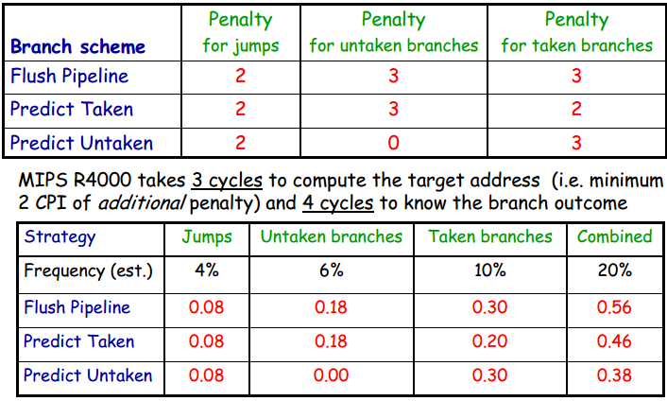
Example: Branch Penalty (in CPI units)
on the MIPS R4000 Processor
Notes:
分支代价，CPI (以MIPS R4000 为例)
假定采用 三种策略：清空流水线、预测成功、预测未成功（表的最左边的那一列）
该机器 的分支指令中计算出目标地址需要3个周期，因此最少需要2个额外的周期，需要4个周期获取是否分支的结果
对于上表而言，
1. 对于无条件跳转，由于需要等待2个周期，获得跳转地址，三种策略，因此其基本的代价为 2个周期（无论是采用哪种策略）
2. 对于条件跳转中不跳转的策略情况，清空流水线或者发生跳转，由于需要等待结果出来，那么需要3个周期(因为第4个周期才能确定是否要跳转)，但是假定不跳转，那么在损失为0
3. 对于，条件跳转发生跳转的策略情况，则三种策略的损失分别我3,2（需要生成跳转地址的时间，在之前不能开展下一条指令的IF阶段）, 3（由于实际发生了跳转，需要将进入流水线中的指令设置为NOOP）
下表则表示 三种策略下，平均每条指令的Stall周期数量

Slide 52
Regarding Branch Instructions
Some Branches in some implementations are finished at MEM, new PC available at the next cycle.
  ID decodes it, EXE calculates the target address and tests the condition, and MEM writes the result to PC.
Some Branches in some implementations are finished at EXE, new PC available at the next cycle. (Most Conditional Branches)
  ID decodes it, EXE calculates the target address and tests the condition and writes the result to PC.
Some Branches in some implementations are finished at ID, new PC available at the next cycle (Most Jumps or System Calls)
  At the ID stage, while the instruction is being decoded, the target address calculation and condition evaluation are also calculated by assuming it is a Branch. At the end of ID, the PC will be updated with either PC+4 (the assumption is wrong), or the new calculated target (the assumption is right).
  An dedicated adder is needed at ID stage for target calculation.
Notes:
关于分支指令的实现方法
1.一些流水线在实现时，将分支指令在MEM（周期）结束，在下一个周期可用新PC。
-ID解码，EXE计算目标地址并测试条件，MEM 周期将结果写入PC。
2. 有些实现方式则在EXE阶段结束，下一个周期就存在可用的新PC地址。 （大多条件分支指令）
-ID解码它，EXE 解散计算目标地址并测试条件后并将结果写入PC。
3. 某些实现则在ID阶段完成，下一个周期可用的新PC（大多数跳转或系统调用）
-在ID阶段，当指令被解码时，目标地址计算和条件评估也通过假设它是一个分支来计算。 在ID结束时，PC将更新为PC + 4（假设错误）或新计算的目标（假设是正确的）。
-在ID阶段需要专门的加法器来进行目标计算。

Slide 53
Terminology for Instruction States
Fetched: instruction has been retrieved from the I-Cache
Decoded: instruction has completed the ID stage
Issued: instruction has been decoded and has started its execution
  In MIPS, it has moved from ID to EX
Executed: instruction has completed its execution in the EX stage
Committed: instruction is guaranteed to complete
  In MIPS, it has entered the WB (or the end of the MEM stage) and the status vector doesn’t contain any exception flag for it
Notes:
简单给出相关指令状态的术语
取指令：指令已从I-Cache中检索
解码：指令已完成ID阶段
发射：指令已被解码并已开始执行
-在MIPS中，它已经从ID转移到EX
已执行：指令已在EX阶段完成其执行
已经完成：指令保证已经完成
--在MIPS中，它已经进入了WB（或MEM阶段的末尾），并且状态向量不包含任何异常标志

Slide 54
Extend to multi-cycle operations
The EX of FP cannot be done in 1 or even 2 cycles.
FP instructions can have the same pipeline as the integer instructions, with two important changes:
  First, there could be multiple EX cycles for a FP operation—the number of cycles can vary for different operations.
  Second, there may be multiple FP units. A stall will occur if the instruction to be issued will cause either a structural hazard for the unit it uses or a data hazard.
Job description of the 4 units:
  The main integer unit handles loads/stores, integer ALU, Branches
  FP adder handles FP add, subtract, and conversion
  FP and integer multiplier
  FP and integer divider
Notes:
扩展多周期操作部件
1. FP浮点数据的EX不能在1个甚至2个周期内完成。
2. FP浮点指令可以具有与整数指令相同的流水线，但有两个重要变化：
-首先，FP操作可能有多个EX周期 - 不同浮点运算，其周期数可能会有所不同。
-其次，可能有多个FP单元。 如果要被执行指令会对其使用的单元造成结构性冒险或造成数据冒险，从而导致流水线阻塞。
3. 4个单元的功能描述（MIPS）：
- 主整数单元处理加载/存储，整数ALU，分支
- FP加法器处理FP加，减和转换
- FP 和 整数乘法器
- FP 和 整数除法器

Slide 55
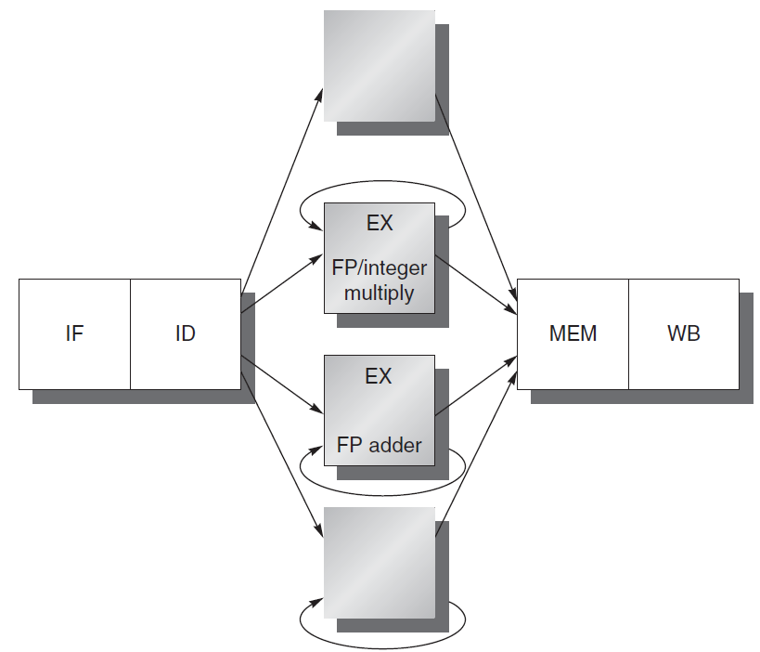
The MIPS pipeline with unpipelined FP units.
Assume that the EXE stages of these units are not pipelined. No other instruction using that unit may issue until the previous instruction leaves EX.
If an instruction cannot proceed to EX, the entire pipeline behind that instruction will be stalled.
Notes:
带有非流水线FP单元的MIPS流水线
1.假设这些单元的EXE阶段没有流水线化。 在前一条指令离开EX之前，不得使用该单位发出其他指令。
2.如果一条指令不能进入EX，则该指令后面的整个流水线将停止。
请大家思考一下这种流水线的效率？

Slide 56
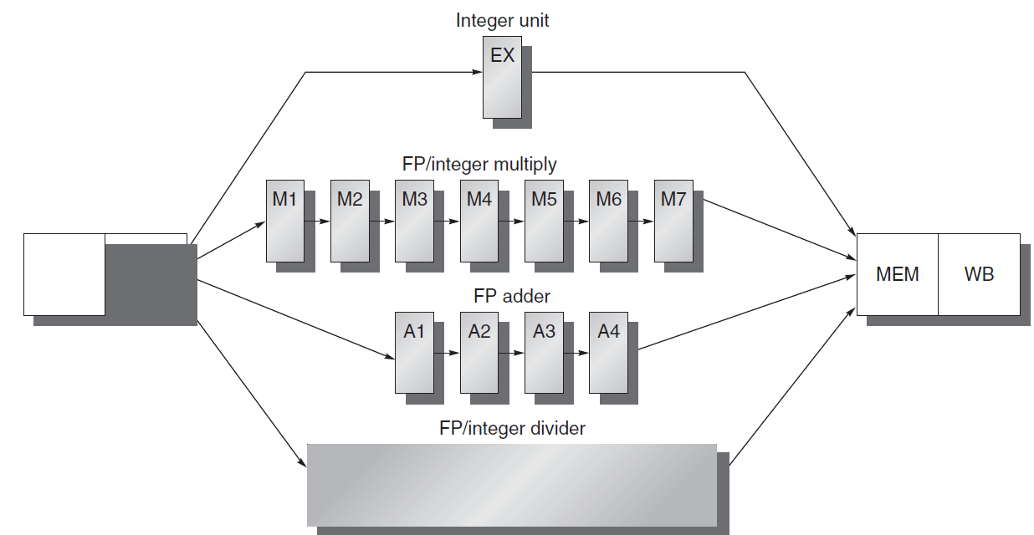
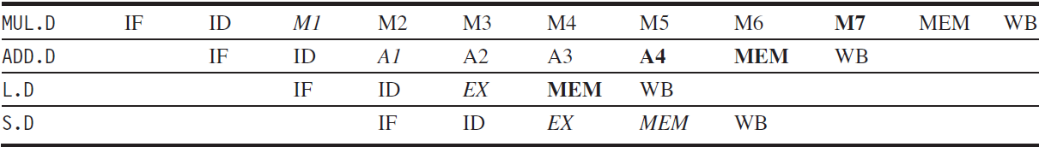
A pipeline supporting multiple outstanding FP operations.
The FP multiplier and adder are pipelined and have a depth of 7 and 4 stages.
The FP divider is not pipelined, but requires 24 cycles to complete.
For example, the 4th instruction after an FP add can use its result without being stalled. Similarly, 7th after an FP multiplier can use its result without being stalled.
Results are ready
Data are needed
Notes:
支持同时执行多个FP运算的流水线技术
1.FP乘法器和加法器是流水线式的，深度分为7级和4级。
2.FP除法器没有流水线，但需要24个周期才能完成，由于只有进入MEM周期后，才允许发射第2条Div指令，因此最少的间隔为25
3.例如，FP添加后的第4条指令可以使用其结果而不会被停顿。 类似的，7个周期后，FP乘法器可以在不失速的情况下使用其结果。

Slide 57
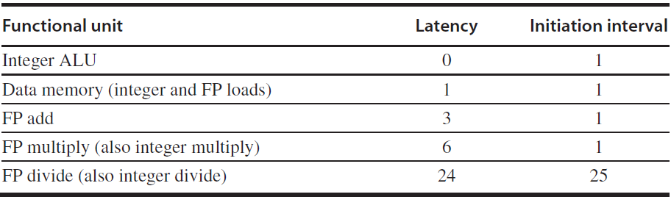
Latency and Initiation
Interval
Two important terms of pipelined operations
  Latency: the number of intervening cycles between an instruction that produces a result and an instruction that uses the result.
  Initiation interval: The number of cycles that must elapse between issuing two operations of a given type.
Since most operations consume their operands at the beginning of EX, the latency is usually the # of stages after EX that an instruction produces a result
  Integer ALU operations are all 0;
  Loads are 1, since their results can be used after one intervening cycle.
  Stores, which consume the value being stored 1 cycle later, are a little different. The latency for the value being stored will be 1 cycle less.
Pipeline latency is essentially equal to 1 cycle less than the depth of the execution pipeline, which is the number of stages from the EX stage to the stage that produces the result.
Notes:
1.流水线操作的两个重要术语
-延迟：产生结果的指令与使用结果的指令之间需要间隔的周期数（对于加法指令，当后面指令进入EX阶段时，上一条指令结果已经生成，通过数据前推输入，因此延时为0 ），该值取决于数据冒险。
-起始时间间隔：发射两条同类型指令之间必须经过的周期数（例如 发送两条整数加法指令的间隔为1，该参数为最小间隔）该间隔取决于结构冒险。
2. 由于大多数操作在EX 阶段开始时使用它们的操作数，所以等待时间通常是EX之后的一个指令产生结果的阶段数
整数ALU操作全部为0;
内存操作LW,SW 为1，因为它们的结果可以在一个周期后使用。
消费1个周期后存储的价值的商店有点不同。 被存储的值的等待时间将少1个周期。
管道延迟基本上等于执行管道深度的1个周期，这是从EX阶段到生成结果阶段的阶段数。
假设

Slide 58
Hazards due to Multiple Outstanding
Operations
• Structural Hazards
– sequential (non-pipelined) function units
• e.g., two “close” DIV operations require stalling
– number of register writes per cycle may be larger than 1
• More Frequent RAW Data Hazards
• “instruction y (which follows instruction x in the program order) tries
to read a source register before x writes it”
– longer latency of operations produces more stalls
• Two New Classes of Data Hazards
– WAW
• “instruction y tries to write a destination register before x writes it”
– WAR – is not possible
• “instruction y tries to write a destination register before x reads it”
• Out-of-order completion
– makes exception handling more complex
Notes:
同时执行多个未完成的操作带来的数据冒险
- 结构冒险
顺序（非流水线）功能单元，例如两个“邻近的”DIV操作需要暂停
每个周期写寄存器的数量可能超过1个
更多的写后读数据冒险
“指令y（按照程序顺序中的指令x）尝试 在x写入之前读取源寄存器“
较长的操作延迟会产生更多的停顿
- 两种新的冒险
写后写：指令y在x写入之前尝试写入目标寄存器
读后写（顺序发射时是不存在的）：指令y尝试在x读取之前写入目标寄存器
-无序完成
使异常处理更加复杂

Slide 59
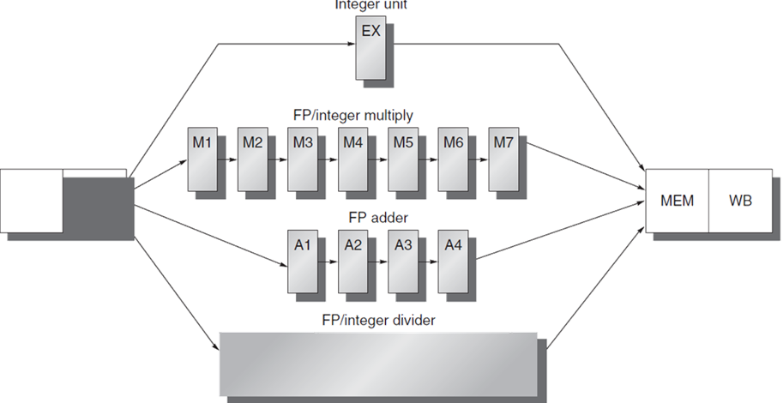
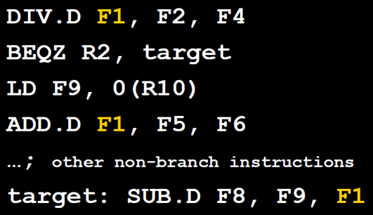
Example: WAW Hazard
Notes:
请同学们分析一下是否存在WAW 冒险的情况，为什么？

Slide 60

Hazards due to Multiple Outstanding
Operations – Example of WAW Hazard
• WAW
• “instruction y tries to write a destination register before x writes it”
• One may wonder how can WAW hazards occur since it may
seem that a compiler would never generate two writes to
the same register without an intervening read
• However such sequences do occur2,
– e.g., a program may take a path that
the compiler cannot predict, e.g. due
to an intervening branch
• Also, in the case of multiple-issue
pipelines, an intervening read may
be present (and stalled) while the
second write could progress
• In this example, if the branch is not taken, a WAW is possible when the DIV completes its execution after the BEQZ, LD, and ADD complete theirs
Notes:
多个未完成操作造成的危害 - WAW危害的例子
WAW: 指令y（按照程序顺序中的指令x）尝试 在x写入之前读取源寄存器
1. 人们可能会想知道WAW如何发生危害，因为似乎编译器在没有插入读取的情况下永远不会产生两次写入同一寄存器（因为该寄存器没有被使用，就被更改了，现代编译器一般会提醒这种情况）.
但是凡事都有例外
2. 例如： 程序可能采取编译器无法预测的路径，例如， 由于两个个Write 操作中间存在分支指令
在这个例子中：在分支指令（BEQZ）不执行的条件下，LD和ADD完成后DIV才完成其计算，可能会发生WAW 冒险，冒险的结果是，本来寄存器F1中应当保存 F5+F6的值，但是由于 DIV.D 指令后执行完毕，F1中保存了 F2 / F4 的值，其结果就是 Taget ： 后面的指令使用F1就会出现错误。
3. 另外，对于多发射的流水线，可能会出现中间读取（并且被阻塞），而第二次写入也可能会进行写操作而导致的WAW 冒险

Slide 61
Hazards due to Multiple Outstanding
Operations – Example of Structural Hazard
Instruction
1
2
3
4
5
6
7
8
9
10
11
MUL.D F0,F4,F6
IF
ID
M1
M2
M3
M4
M5
M6
M7
MEM
WB
ADD R1, R3, R4
IF
ID
EX
MEM
WB
ADD R2, R4, R5
IF
ID
EX
MEM
WB
ADD.D F2,F4,F6
IF
ID
A1
A2
A3
A4
MEM
WB
ADD R6, R9, R7
IF
ID
EX
MEM
WB
ADD R8, R3, R9
IF
ID
EX
MEM
WB
Fig. C.38
IF
ID
EX
MEM
WB
L.D F2, 0(R2)
•
With only 1 write port in register file, the processor must serialize the 3 WB instructions
– Option 1: Tracking port access during ID and (pre)-stalling corresponding instruction (same logic as
for interlock detection)
– Option 2: Stall the conflicting instructions with smaller latency (“least-waited”) just before MEM
or WB
• Notice that there is no structural hazard at MEM because, among the 3 instructions, only L.D really needs to
access memory. However, this assumes that there is extra HW to make the other two instructions
progress into WB as they need
Notes:
多个未完成操作造成的数据冒险 - 结构冒险的例子
由于 只有一个寄存器的写入端口，处理器必须将三个WB操作串行化处理
- 方法1： 在相应指令的ID 指令译码和和（预）-暂停 期间跟踪端口访问（互锁检测逻辑 相同，) ----相当于提前检测冲突
- 方法2： 在MEM周期和WB周期之前，以较小的延迟（“最少等待”）暂时挂起冲突的指令 ---相当于实时检测冲突
•请注意，MEM没有结构冒险，因为在这3条指令中，只有L.D才真正的需要访问内存，其它两条指令在内存周期不会访问内存。
但是，这假设有额外的硬件来判断使其他两个指令进入WB 操作

Slide 62
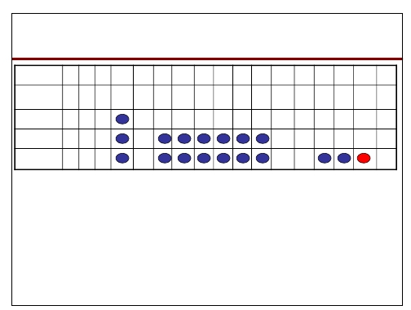
Hazards due to Multiple Outstanding
Operations – Example of RAW Hazard
Instruction
1
2
3
4
5
6
7
8
9
10
11
12
13
14
15
16
17
L.D
IF
ID
EX
MEM
WB
F4, 0(R2)
MUL.D
IF
ID
M1
M2
M3
M4
M5
M6
M7
MEM
WB
F0,F4,F6
ADD.D
IF
ID
A1
A2
A3
A4
MEM
WB
F2,F0,F8
S.D
IF
ID
EX
MEM
F2, 0(R2)
Fig. C.37
• Deeper pipelines increase the stall frequencies
– each instruction in the example depends on the previous one
– each instruction proceeds as soon as the awaited data become
available (optimal forwarding)
– to avoid a RAW hazard the S.D must wait for the ADD.D to
provide the new value of F2 (via bypassing) before entering MEM
*Note: Fig. C.37 is not consistent with Fig. C.38 on the handling of structural hazards: it implies that a structural hazard exists on MEM in Cycle 16; this happens when no extra hardware handles the conflict
Notes:
图中蓝色的周期是阻塞周期（红色的部分表示如果没有专门的硬件，将会导致在MEM结构冒险）
多个未完成操作造成的数据冒险危害 – 写后读冒险RAW举例
更深的流水线线，将导致更高的阻塞频率（需要每条指令在进入每个阶段之前都进行阻塞检测）
- 示例中的每条指令都依赖于前一条指令
- 数据一旦可用，指令就可以执行，可用（数据前推来优化）
- 为了避免RAW冒险，S.D必须在进入MEM之前等待ADD.D 计算出寄存器F2新的值（通过旁路）
注：图C.37与处理结构性危害的图C.38（与前一个图）不一致：这意味着在周期16中MEM存在结构性危害; 这发生在没有额外的硬件处理冲突时

Slide 63
Hazards due to Multiple Outstanding
Operations – Control Implementation
• Assuming that all hazard detections are done in
ID, before issuing an instruction x we must
– check for structural hazards
• the required function unit must be available (e.g., FP Divisor)
• no future conflicts on the register write port
– check for RAW data hazards
• no conflict between x’s source register and previous
instruction destination registers
– e.g. if x is a FP operation on F2, check that F2 is not a
destination in ID/A1, A1/A2, A2/A3
– check for WAW data hazards
• no instruction in A1,…,A4, D, M1,…M7 can have the same
register destination as x
• Logic implementation is similar as for the MIPS
integer pipeline
Notes:
多项未完成指令运行将导致冒险 - 控制冒险的实现方式
•假设所有冒险检测都是在ID中完成，在发射指令x之前我们必须
- 检查结构冒险
•需要的功能单元必须可用（例如，FP除法器）
•寄存器写入端口不存在冲突
- 检查RAW数据冒险
•x的源寄存器与之前指令的目标寄存器没有冲突
例如 ：如果x是F2 上的FP操作，检查 ID / A1，A1 / A2，A2 / A3操作阶段检查F2 不是之前指令的目的地址
- 检查WAW数据冒险
•A1，...，A4，D，M1，... M7中没有指令可以具有与x相同目的寄存器
• MIPS整数流水线采用类似的逻辑实现方法

Slide 64
What Makes Pipelining Hard to Implement?
Exceptional situations where the instruction execution order needs to be changed in unexpected ways.
  Exceptions and Interrupts.
Different instruction sets (skipped)
Notes:
什么使得流水线难以实现
1.异常状态，指令执行顺序需要按照 意料之外的方式执行。
--异常和中断。
2.不同的指令集（暂时不考虑）

Slide 65
Exceptions: hard to handle
An instruction in the pipeline can raise exceptions that may force the CPU to abort the following instructions in the pipeline before they complete.
  CPU needs to make sure that the aborted instructions do not change the CPU state.
Types of exceptions:
  I/O device request
  Invoking an operating system service from a user program
  Tracing instruction execution
  Breakpoint (programmer-requested interrupt)
  Integer arithmetic overflow
  FP arithmetic anomaly
  Page fault (not in main memory)
  Misaligned memory accesses (if alignment is required)
  Memory protection violation
  Using an undefined or unimplemented instruction
  Hardware malfunctions
  Power failure
Notes:
Exceptions: 难以处理
流水线中的指令可能引发异常，这些异常可能会强制CPU在完成之前中止流水线中后继的指令。
CPU需要确保中止的指令不会改变CPU的状态。
2异常的类型：
- I / O设备请求
- 从用户程序调用操作系统服务
- 跟踪指令执行
- 断点（程序员请求的中断）
-整数算术溢出
-FP算术异常
-页面错误（不在主内存中）
-未对齐的内存访问（如果需要对齐）
-内存保护违规
-使用未定义或未实现的指令
-硬件故障
-电源（检测）失败

Slide 66
Characterizing Exceptions
• Synchronous
– event occurs at the same place
every time a program is executed
with the same data
• Coerced
– Caused by HW event not under
control of the user program
• harder to handle, unpredictable
• User Maskable
– can be disabled by user program
• Within Instructions
– typically synchronous
– recognized after instruction has triggered by instructions completed
• Resume
– program execution must be
completed after exception
• Asynchronous
– caused by device external to CPU
and memory
• easier to handle, wait for
completion of current instruction
• User Requested
– requested by user program, these
are not really exceptions, but still
treated in the same way
• easier to handle, wait for
completion of current instruction
• Unmaskable
– cannot be disabled by user program
• Between Instructions
– recognized after instruction has
completed
•Terminate
– event stops program execution
•easier to handle
Notes:
异常的特点。
•同步异常
- 事件发生在同一个地方，可能是内存缺页，数据异常等
• 裹挟性（强迫性）
- 由HW事件引起的不受用户程序的控制
•难以处理，不可预测
•用户可屏蔽
- 可以通过用户程序禁用
• 异常发生在一条指令中
- 通常是同步的
- 在完成指令后触发指令后识别
• 恢复
- 程序在例外之后必须完成
异步
- 由CPU外部的设备引起
和记忆
•更容易处理，等待
完成当前的指令
•请求用户
- 由用户程序请求，这些
不是真的例外，但仍然
以同样的方式对待
•更容易处理，等待
完成当前的指令
•无法屏蔽
- 用户程序无法禁用
•在指令之间
- 经过指导后认可
完成
•终止
- 事件停止程序执行
•更容易处理

Slide 67
Maintaining Precise Exceptions with
Long-Running Instructions
DIV.D F0,F2,F4 • No dependencies, but likely we
ADD.D F10,F10,F8 have out-of-order completion
SUB.D F12,F12,F14
• Possible Imprecise Exception Problem if, for instance,
– SUB.D causes an exception at the point where ADD.D has
already completed but DIV.D has not yet
– further, if also DIV.D causes an exception, the state of the
system is left inconsistent i.e.
• as before DIV.D was executed but with a new value for F10
•
Possible solutions
1.
ignore the problem and settle for Imprecise Exception
2.
buffer the results until all previously issued operations complete
3.
let the trap-handling routine rebuild the sequence of exceptions
4. allow instructions to complete only if all previously issued ones
cannot have exception anymore (implemented using stalling)
Notes:
长时间运行的指令，维护精确异常问题
1. 对于左边程序片段，不存在依赖关系，但是可能存在乱序完成的问题
非精确的异常断点导致的问题
- 例如我们的异常（中断）在 SUB.D 指令时发生，但DIV.D 指令可能还没有结束
- 进一步，如果在DIV.D 中导致了异常，系统的状态可能也会存在不一致的问题。如前述，由于加法已经完成，如果从断点重新执行，那么F10可能的值是一个新的值。结果就是错误的！！
3. 可能的解决方法是：
1. 最简单，忽略所有可能导致非精确异常导致的问题
2. 缓存结果，直到之前的发送的指令操作结束
3. 让陷阱处理程序重建异常序列（将影响的指令重新执行一遍）
4. 只要当发射的指令执行完毕之后才能够响应异常（利用阻塞机制），异常响应不及时。
本章的重点是流水线的顺序执行过程如何避免冒险的技术
冒险的识别和控制冒险的问题（主要就是 挂起流水线）

Slide 68
处理中断4种可能的办法（1,2两种）
方法1：忽略这种问题，当非精确处理
  原来的supercomputer的方法
  但现代计算机对IEEE 浮点标准的异常处理，虚拟存储的异常处理要求必须是精确中断。
方法：缓存操作结果，直到早期发射的指令执行完。
  当指令运行时间较长时，Buffer区较大
  Future file (Power PC620 MIPS R10000)
    缓存执行结果，按指令序确认
  history file (CYBER 180/990)
    尽快确认
    缓存区存放原来的操作数，如果异常发生，回卷到合适的状态

Slide 69
第3 & 4种方法
方法：以非精确方式处理，用软件来修正
  为软件修正保存足够的状态
  让软件仿真尚未执行完的指令的执行
  例如
    Instruction 1 – A 执行时间较长，引起中断的指令
    Instruction 2, instruction 3, ….instruction n-1 未执行完的指令
    Instruction n 已执行完的指令
    由于第n条指令已执行完，希望中断返回后从第n+1条指令开始执行，如果我们保存所有的流水线的PC值，那么软件可以仿真Instruction1 到Instruction n-1 的执行
方法4：暂停发射，直到确定先前的指令都可无异常的完成，再发射下面的指令。
  在EX段的前期确认（MIPS流水线在前三个周期中）
  MIPS R2K to R4K 以及Pentium使用这种方法

Slide 70
Homework #2
Page C-82: Question C.1, C.3, C.7

Slide 71
In-class Quiz #1

